Slide 1

Music Recommender System
Student : Neremzoiu Ionuț-Dragoș
Scientific Coordinator : Prof. Univ. Dr. Ing. Costin Bădică
IULIE 2022

Slide 2





Why Recommender Systems?
They have increasingly become an essential part of daily online activities (e.g. Netflix, Spotify, Amazon, etc.)
By having a general or an instinctual idea of how such systems work, one can make use of it, by making it generate recommendations as relevant as possible according to one’s tastes, preferences, etc.

Slide 3
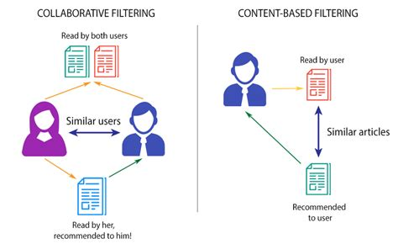
Classification of Recommender Systems
Collaborative filtering : relies on past interactions between users and items (ratings given by users on items, whether a user viewed an item or not, times a user viewed an item during a timespan,etc.) to recommend items to a user based on interests of a similar user.
Content-based filtering: uses item features to suggest other items similar to what the user likes/interacts with.

Slide 4
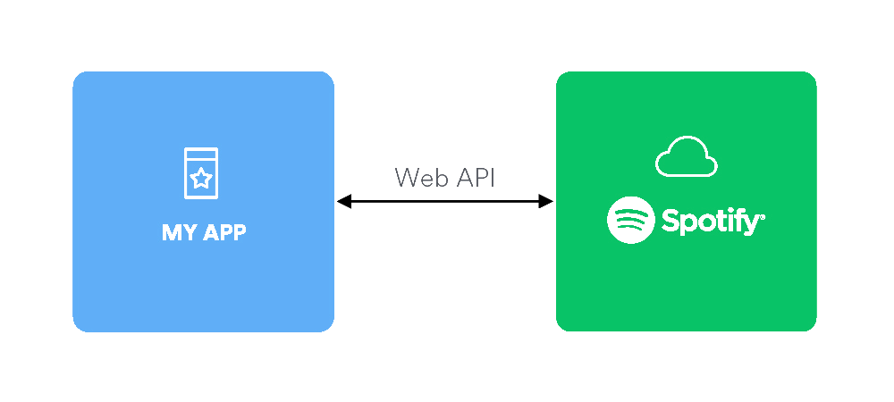
Dataset(s) used
2 different datasets collected via Spotify Web Platform API
Both have common and different attributes
Both can only be used for content-based approaches

Slide 5
Common features
Mood : Danceability, Valence, Energy, Tempo
Properties: Loudness, Speechiness, Instrumentalness, Duration
Context : Liveness, Acousticness

Slide 6
Mood
Danceability : measures how suitable a track is for dancing based on a combination of musical elements including tempo, rhythm stability, beat strength and overall regularity.
Valence : describes the musical positiveness conveyed by a track. The higher the valence, the more positive (e.g. happy, cheerful, euphoric). The lower the valence, the more negative (e.g. sad, depressed, angry).
Energy : represents a perceptual measure of intensity and activity. Typically, energetic tracks feel fast, loud and noisy. (e.g. metal and rock will have energy)
Tempo : overall estimated tempo of a track in beats per minute (BPM). It is speed or pace of a given piece and derives directly from the average beat duration.

Slide 7
Properties
Loudness : The overall loudness of a track in decibels (dB).
Speechiness : detects the presence of spoken words in a track. The more exclusively speech-like (e.g. talk show, audio book, poetry), the closer the attribute value.
Instrumentalness : highlights if a track contains no vocals. The higher the value, the higher the chances for a track of having no vocal content.
Duration : duration of a track in milliseconds.

Slide 8
Context
Liveness : detects the presence of an audience in the recording. Higher values represent an increased probability that the track was performed live.
Acousticness : A confidence measure from 0.0 to 1.0 whether the track is acoustic. 1.0 represents high confidence that the track is acoustic.

Slide 9

Statistical data

Slide 10
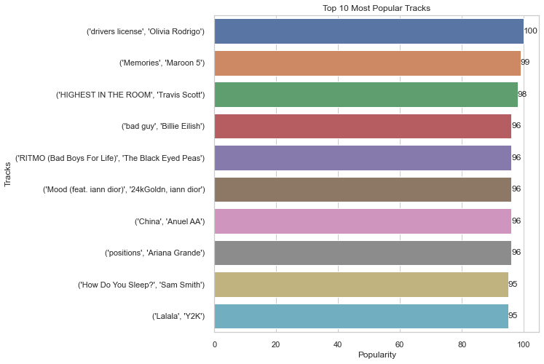
Top 10 Most Popular Tracks

Slide 11
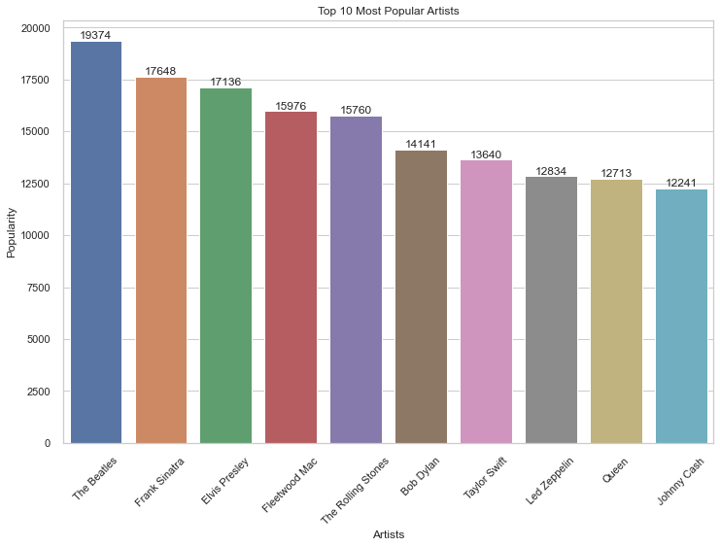
Top 10 Most Popular Artists

Slide 12
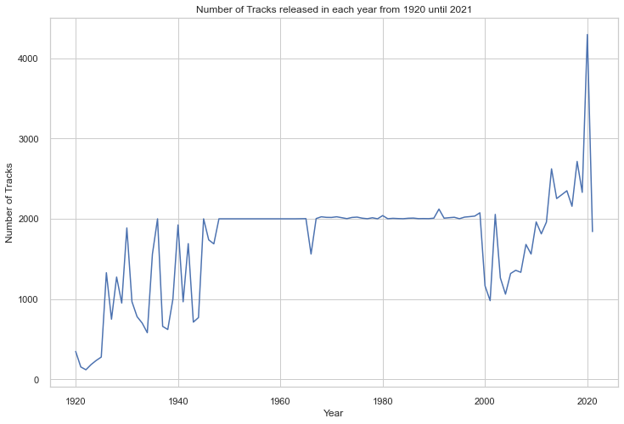
Number of tracks released in each year from 1920 to 2021

Slide 13
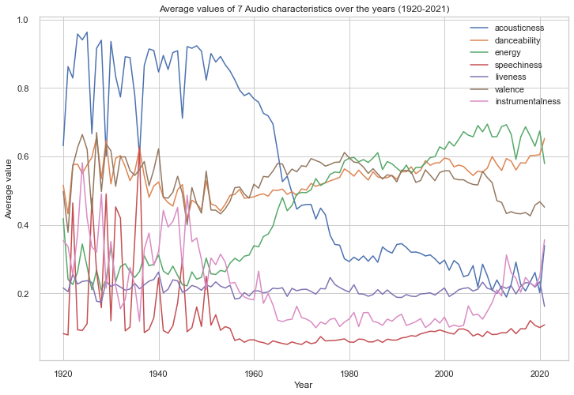
Average values of 7 Audio characteristics from 1920 to 2021

Slide 14
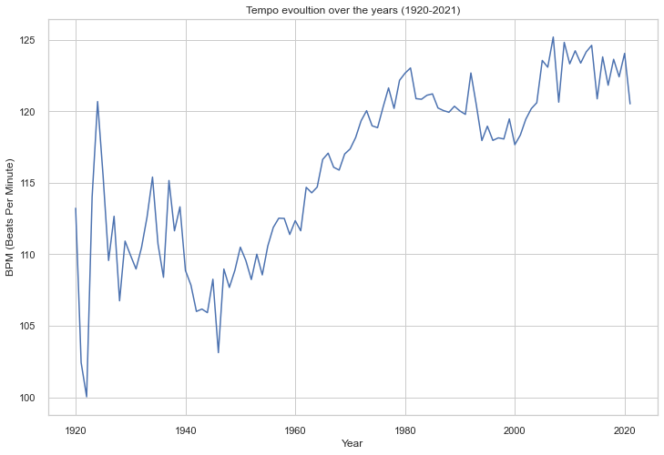
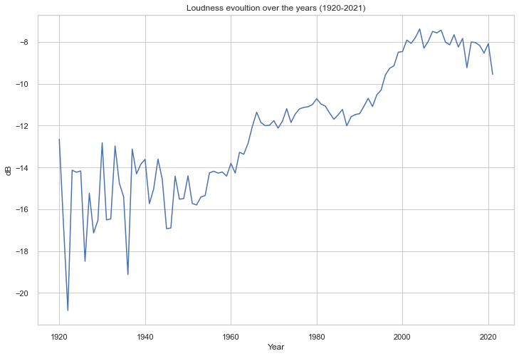
Tempo and loudness evolution over the years (1920-2021)

Slide 15
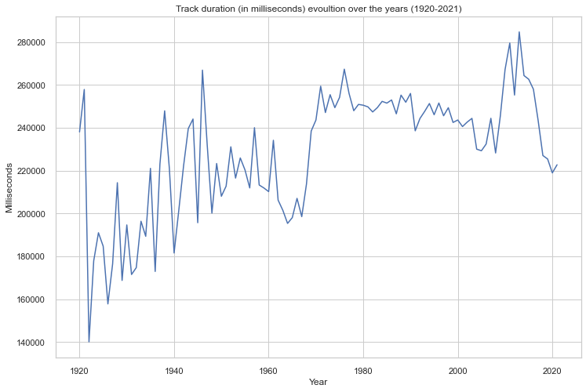
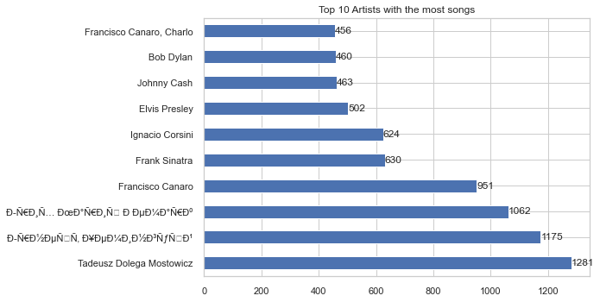
Track duration (in milliseconds) evolution over the year (1920-2021) and Top 10 Artists with most songs

Slide 16
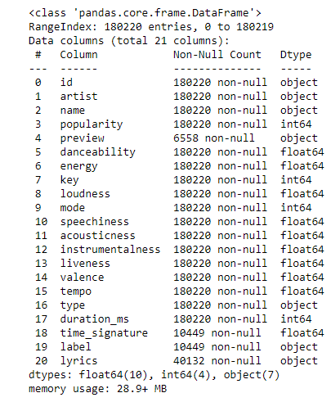
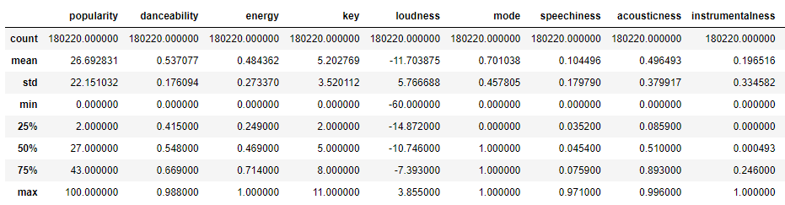
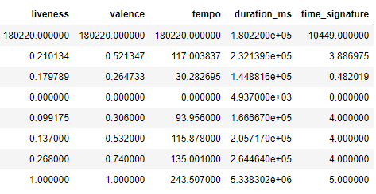
Final dataset info

Slide 17

Data preprocessing

Slide 18
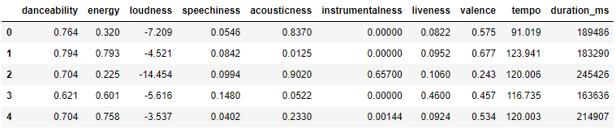
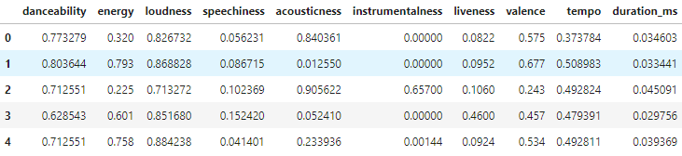
Feature Selection and Min-Max Scaling
Firstly, only the numerical common features are extracted in order to be further used in data preprocessing.
Features selected before Min-Max
Features selected after Min-Max
Min-Max Scaling
$x′=\frac{x − min(x)}{\max\left(x\right) − min(x)}$, $such that$ $x^{′}∈\left[0,1\right]$, where $x^{′}$ is any value from the selected features

Slide 19
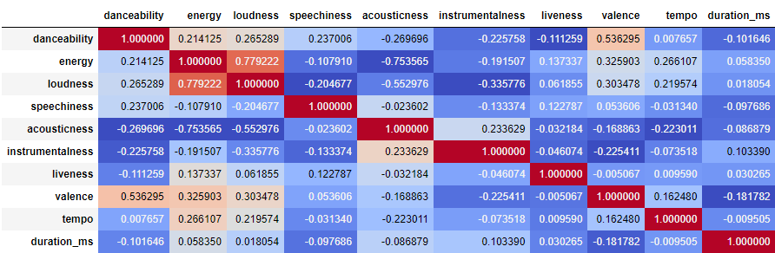
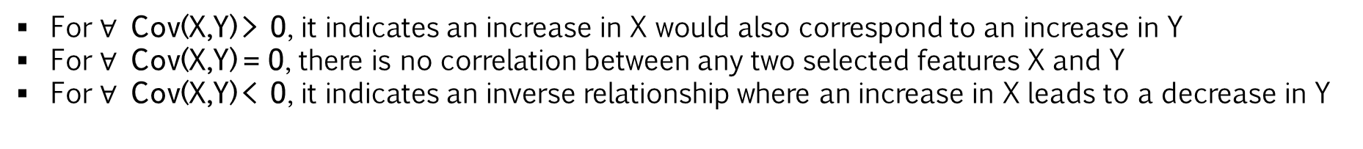
Feature Correlation
For $∀$ Cov(X,Y) > 0, it indicates an increase in X would also correspond to an increase in Y
For $∀$ Cov(X,Y) = 0, there is no correlation between any two selected features X and Y
For $∀$ Cov(X,Y) < 0, it indicates an inverse relationship where an increase in X leads to a decrease in Y

Slide 20
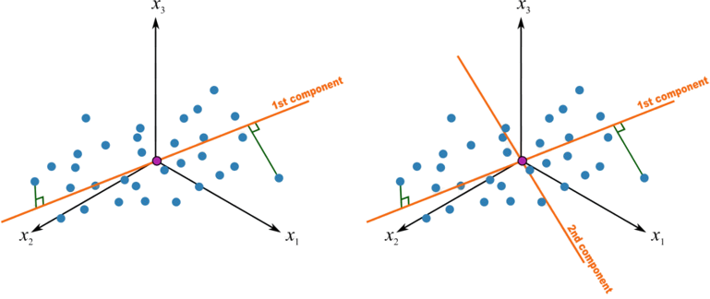
Data Reduction
Principal Component Analysis (PCA)
is a commonly technique used for dimensionality reduction by projecting each data point onto only the first few principal components to obtain lower-dimensional data while preserving as much of the data’s variation as possible.
transforms data linearly into new properties that are not correlated with each other.
is often computed by eigendecomposition of the data covariance matrix or singular value decomposition (SVD) of the data matrix.

Slide 21
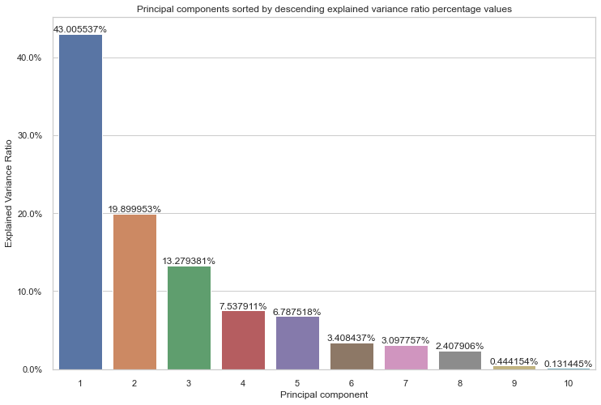
Data Reduction
Each principal component by explained variance ratio

Slide 22
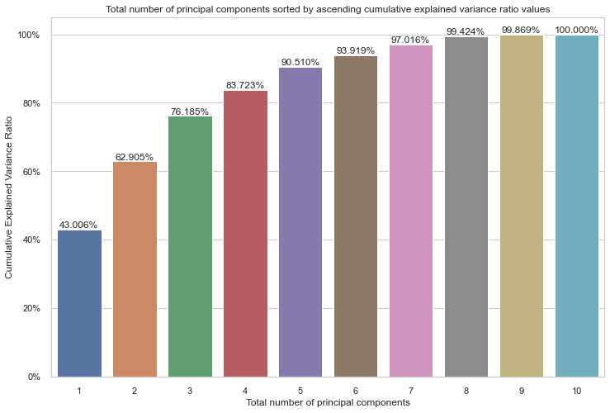
Data Reduction
Total number of principal components by cumulative explained variance ratio

Slide 23
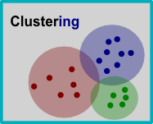
Clustering
is the task of grouping a set of objects in such a way that objects in the same group (called a cluster) are more similar (in a sense) to each other than those in other groups (clusters)
is not a specific algorithm, but a general task to be solved nonetheless by various algorithms that differ significantly in their understanding of what constitutes a cluster and how to efficiently find them.

Slide 24
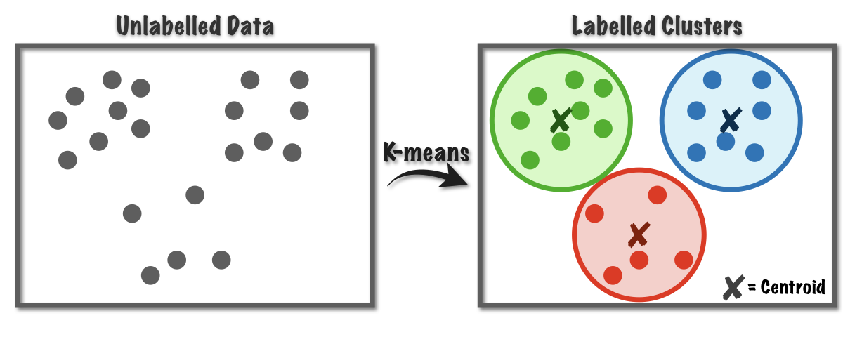
K-Means clustering
is an iterative algorithm that divides the unlabeled dataset into k different clusters in such a way that each data point belongs to only one group that has similar properties.
is a centroid-based algorithm, where each cluster is associated with a centroid.
the aim of this algorithm is to minimize the sum of distances between data points and their corresponding cluster.

Slide 25
K-Means clustering
Pros
relatively simple to implement
scales to large data sets
guarantees convergence
can warm-start the position of centroids *(de reformulat)*
easily adapts to new examples
generalizes to clusters of different shapes and sizes (e.g. elliptical clusters)
Cons
choosing k manually
being dependent on initial values
clustering data of varying size and density
scaling with number of dimensions

Slide 26
Finding optimal K for K-Means clustering
Silhouette
Is a measure of how similar an object is to its own cluster compared to other clusters.
ranges from -1 to +1, where a high value indicates that the object is well matched to its own cluster and poorly matched to neighbouring clusters.
can be computed with any distance metric (e.g. Euclidiean, Manhattan)
Elbow method
Plots various values of cost (SSE – sum of squared errors) with changing k.
As the value of k increases, there will be fewer elements in the cluster.
The lesser number of elements means closer to the centroid.
Calinski-Harabasz Index
assumes that very compact and well-spaced from each other clusters are good.
is calculated by dividing the variance of the sums of squares of the distances of individual objects to their cluster center by the sum of squares of the distance between the cluster centers.
Higher the index value, the better the clustering model.
The point where this distortion declines the most is the elbow point.

Slide 27
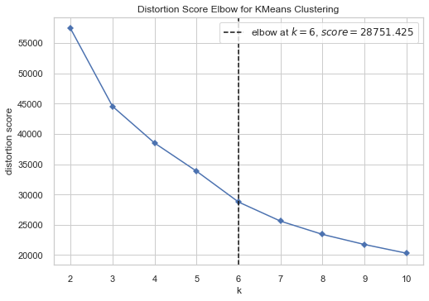
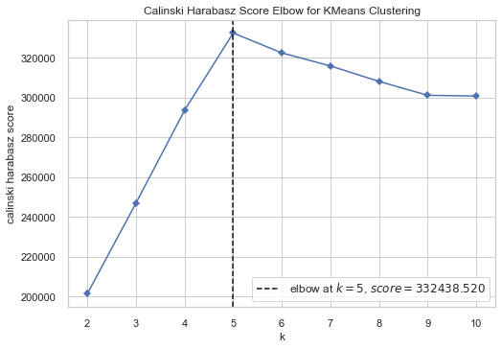
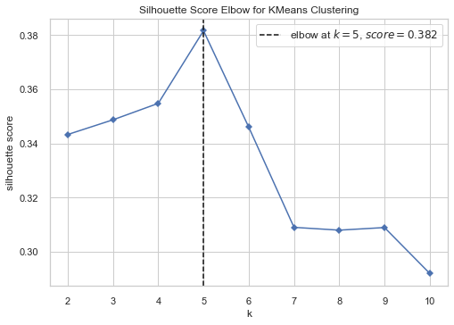
Finding optimal K for K-Means clustering
6 principal components => 93,9%
2 principal components => 62,9%
5 principal components => 90,5%

Slide 28
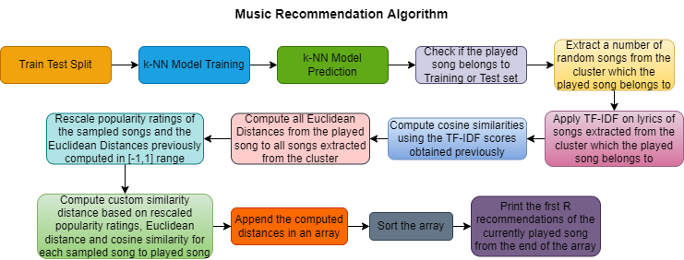
Recommendation algorithm

Slide 29
Recommendation algorithm - approaches
Train Test Split
80-20 ratio => 144,176 songs for training and 36,044 for testing.
ML model is based on the training set in order to make predictions which can then be used for evaluation purposes, when comparing with actual (test) values.
k-NN
non-parametric supervised learning method used both for regression and classification.
For both cases, the input consists of the k closest training examples in a dataset.
For classification, the output is a class membership. An object is classified by plurality vote of its neighbours, with the object being assigned to the class most common among its k nearest neighbours.
TF-IDF
evaluates how relevant a word is to a document in a collection of documents.
is done by multiplying two metrics : how many times a word appears in a document (TF) and inverse document frequency of the word across the set of documents (IDF)

Slide 30

Recommendation algorithm – Formula scalings
$$MinMaxPopularity(c)=−1+\frac{Popularity\left(c\right)−min\left(P\right)∗2 }{max\left(P\right)−min\left(P\right)}$$
$$MinMaxEuclideanDist\left(c\right)=1−\frac{EuclideanDist\left(c,p\right)−minEuclideanDist\left(D\right)∗2 }{maxEuclieanDist\left(D\right)−minEuclideanDist\left(D\right)}$$
$$CustomDist\left(c,p\right)=\frac{MinMaxPopularity\left(c\right)+\cos\left(c,p\right)+MinMaxEuclideanDist\left(c,p\right)}{3}$$

Slide 31

Evaluation of experimental system

Slide 32
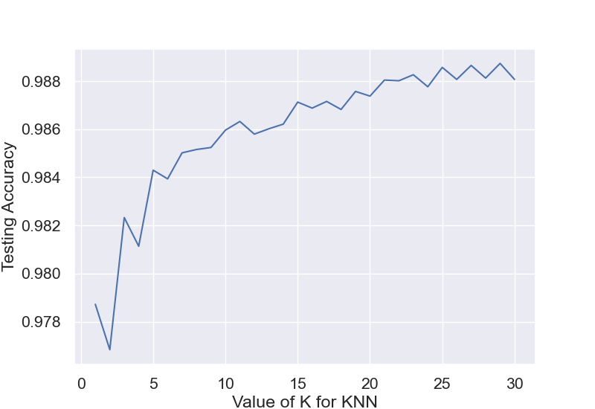
Best k for k-NN

Slide 33
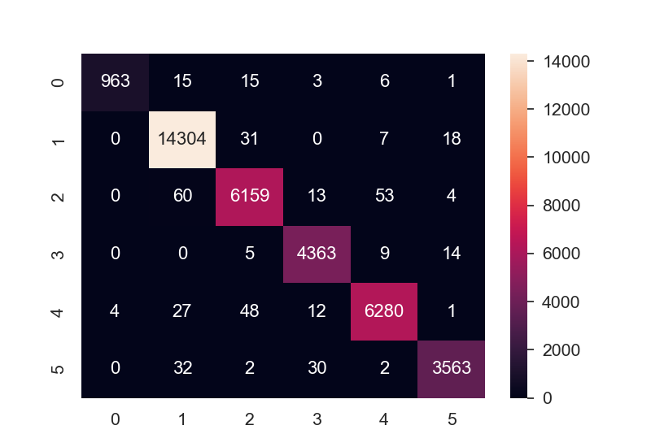
Confusion Matrix results
a specific table layout that allows visualization of the performance of an algorithm, typically a supervised learning one.
each row represents the instances in an actual class while each column represents the instances in a predicted class (or vice versa).

Slide 34
Conclusions, limitations and improvements to be made
Due to lack of user data, recommendations cannot be personalized and human-based evaluations metrics are not applicable.
So far, there are few song lyrics collected.
Recommendation algorithm is slow performance-wise due to space and time complexity for TF-IDF

Slide 35

Thank you for your attention !

